Slide 1
Essential Studies Transfer Impact Study Preliminary Results, June 2017

Slide 2
Essential Studies: Defining the “Oregon Tech Experience”
Shaping Distinctive Graduates
General education that’s more than the sum of its parts, that supports success within the discipline and in life, that produces skilled, multifaceted, creative problem-solvers.
General education that is “uniquely Oregon Tech” – hands-on, applied, workforce-relevant
(and recognizing our mix of students, including transfers)
Notes:
Distinct Experience--Sandra
There is a lot of pressure for institutions of higher education to create an educational experience that is nice, convenient and possibly even easy.
A distinct experience is memorable and personal. This is the experience which will create graduates.
Nice, convenient and easy is viewed as “Time well saved”
Memorable and personal experiences are viewed as “Time well spent”
Time well saved equals--time watching the clock; box checking; jumping through hoops; accumulating credits
Time well spent equals—engaged students, engaged faculty, engaged alums

Slide 3
Transfer Impacts
Any changes to any general education will have transfer impacts:
- Negative: extra credits/cost/time to degree
- Positive: enhanced educational experience (knowledge and skills), greater student success and workforce readiness, distinctive and marketable curriculum elements.
(This tension and tradeoff already exists between programs, too.)
Impacts should be identified, justified, and minimized – iterative testing and refinement of Essential Studies.
Transfer was in mind from the beginning.
Notes:
Distinct Experience--Sandra
There is a lot of pressure for institutions of higher education to create an educational experience that is nice, convenient and possibly even easy.
A distinct experience is memorable and personal. This is the experience which will create graduates.
Nice, convenient and easy is viewed as “Time well saved”
Memorable and personal experiences are viewed as “Time well spent”
Time well saved equals--time watching the clock; box checking; jumping through hoops; accumulating credits
Time well spent equals—engaged students, engaged faculty, engaged alums

Slide 4
Fall 2013 GERTF Faculty Forum survey results

Slide 5
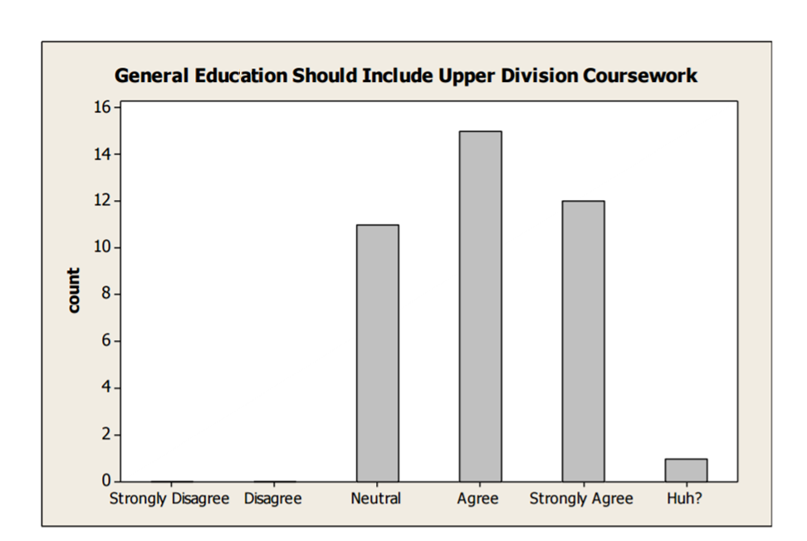
Fall 2013 GERTF Faculty Forum survey results

Slide 6
Fall 2013 GERTF Faculty Forum survey results

Slide 7
Prior General Education Model
Pros: unusually large buckets makes transfer easy Cons: poor alignment with student outcomes (which are also workforce/employer needs) minimal vertical development, little integration with discipline.
36 M/S or 45 M/S/SS (typically integrated with major requirements)
Humanities
Communication*
*WRI111, 122, SPE111, 321
Math/Science** **1 lab science
Social Sciences

Slide 8
Essential Studies Model
More intentional (and smaller) bins, aligned with outcomes, reinforced in courses in the major, integrated within & across disciplines.
Synthesis
Disciplinary Capstone
ESSE
Program-Integrated Practice Essential Practice Foundation
Communication* *WRI121, 122, SPE111
Inquiry & Analysis** **Hum, Soc. Sci, Nat. Sci
Ethical Reasoning
Teamwork
Quant. Literacy
Diverse Persp.

Slide 9
Parameters for Transfer Study
Fall ’16: Vetted by stakeholders (GEAC, Transfer Team, admin)
Stratified sampling: 3 groups of 30 each, Fall ‘16 entering students:
Group A (direct from HS, <36 credits, N=157)
Group B (transfer, <90 credits, N=178)
Group C (transfer, >90 credits, N=381)
(Excluded: Postbacs, N=53 – separate policy)
90 Student ID’s pulled by IR; 2048 transfer courses. Existing degree audits tell us how these courses apply in the major.
Notes:
Distinct Experience--Sandra
There is a lot of pressure for institutions of higher education to create an educational experience that is nice, convenient and possibly even easy.
A distinct experience is memorable and personal. This is the experience which will create graduates.
Nice, convenient and easy is viewed as “Time well saved”
Memorable and personal experiences are viewed as “Time well spent”
Time well saved equals--time watching the clock; box checking; jumping through hoops; accumulating credits
Time well spent equals—engaged students, engaged faculty, engaged alums

Slide 10
Process for Transfer Study
Transfer study: How do transfer courses apply under Essential Studies (and how is that different from currently)?
To answer this:
Every program created a draft curriculum map (first step towards CPC submission); ~2-4 hours/program.
Gen ed department chairs evaluated transfer courses under new criteria (helps us develop clear protocols): 4 chairs, ~5-15+ hours each.
Assembled, collated, and analyzed data (SA, NS, SB): 60+ hours.

Slide 11
Where are we not applying credits now?
6351.5 credits come in to Oregon Tech; 3091.75 are applied (48.7%)
Of the 3200+ credits that not applied:
No applicable category in degree map: 1702.2 credits
(Vocational: 501 credits; PE: 90 credits)
Matches category in model, but block is full: 680.5 credits
Remedial: 384+ credits (not counted above)
Fractional credit loss: 364.5 credits
Below the level required by a program: 230.5 credits
Beyond the level required by a program: 165 credits
Student has credit for course twice: 82 credits

Slide 12
Group A (“Direct from HS”)
Locations/Modes
Klamath Falls (28)
Wilsonville (2)
Common Majors
Software Engineering Technology (6)
Pre-Medical Imaging (5)
Biology-Health Sciences (4)
Mechanical Engineering (4)
Pre-Dental Hygiene (2)
Pre-Nursing (4) – excluded
Common Transfer Institutions
Klamath CC (4)
Advanced Placement (4)
Southern Oregon U (3)
Rogue CC (2)
Portland State U (2)
Portland CC (2)
Eastern Oregon U (2)
Chemeketa CC (2)

Slide 13
Group A (“Direct from HS”)
Average student brings in 16.5 credits.
Under old general education model, 8.7 credits (52.5%) applied:
Humanities | 1.3 credits/9 (0.4 courses/3)
Communication (Lower-Division) | 1.2 credits/9 (0.4 courses/3)
Communication (Upper-Division) | 0.0 credits/9 (0.0 courses/3)
Social Sciences | 1.5 credits/12 (0.5 courses/4)
Math/Science | 4.1+ credits (1.0 courses+)

Slide 14
Group A (“Direct from HS”)
Average student brings in 16.5 credits.
Under Essential Studies, 7.0 credits (42.1%) applied:
 | Foundation | Practicing
Communication | 1.2 credits/9 (0.4 courses/3) | -
Inquiry & Analysis | 1.0 credits/10 (0.3 courses/3) | -
Quantitative Literacy | 0.3 credits/4 (0.1 courses/1) | -
Diverse Perspectives | 0.1 credits/3 (0.0 courses/1) | -
Teamwork | - | N/A
Ethical Reasoning | N/A | -

Slide 15
Group A (“Direct from HS”)
Where are losses in transition? (43 credits total; 1.7 credits/student from Group A)
Fractional Credit Loss (2 credits)
This was mostly “hidden” fractional loss under old model, too.
Carving up Hum block (18 credits)
Carving up SS block (17 credits)
2nd year language Credits (6 credits) – can apply in Hum Block currently – matter for GEAC & ESLO cmtes to consider

Slide 16
Takeaways from Group A
HS students seem to be taking college credits opportunistically.
GEAC and ESLO committees should consider:
How 2nd year language applies;
How AP courses (and IB) can apply.

Slide 17
Group B (“Low-Credit Transfers”)
Locations/Modes
Klamath (20)
Wilsonville (4)
Online (3)
Common Majors
Dental Hygiene (4)
Mechanical Engineering (3)
Pre-Medical Imaging (4)
Pre-Nursing (2) - excluded
Common Transfer Institutions
Portland CC (4)
Klamath CC (4)
Oregon State U (3)
Mt. Hood CC (3)
Chemeketa CC (3)
Rogue CC (2)
Linn Benton CC (2)
Eastern Oregon U (2)
Clackamas CC (2)
Central Oregon CC (2)

Slide 18
Group B (“Low-Credit Transfers”)
Average student brings in 61.5 credits.
Under old general education model, 33.5 (54.5%) applied:
Humanities | 2.2 credits/9 (0.7 courses/3)
Communication (Lower-Division) | 6.7 credits/9 (2.2 courses/3)
Communication (Upper-Division) | 1.0 credits/9 (0.3 courses/3)
Social Sciences | 5.5 credits/12 (1.8 courses/4)
Math/Science | 8.1+ credits (2.0 courses+)

Slide 19
Group B (“Low-Credit Transfers”)
Average student brings in 61.5 credits.
Under Essential Studies, 30.0 (48.9%) applied:
 | Foundation | Practicing
Communication | 6.7 credits/9 (2.2 courses/3) | 0.7 credits/3 (0.2 courses/1)
Inquiry & Analysis | 4.5 credits/10 (1.5 courses/3) | -
Quantitative Literacy | 0.4 credits/4 (0.1 courses/1) | 0.6 credits/3 (0.2 courses/1)
Diverse Perspectives | 0.6 credits/3 (0.2 courses/1) | -
Teamwork | 0.2 credits/3 (0.1 courses/1) | N/A
Ethical Reasoning | N/A | -

Slide 20
Group B (“Low-Credit Transfers”)
Where are losses in transition? (84 credits total; 3.1 credits/student from Group B)
Fractional Credit Loss (21 credits)
Carving up Hum block (14 credits)
Carving up SS block (41 credits)
Carving up other blocks (8 credits)

Slide 21
Takeaways from Group B
Students are being generally strategic about CC courses; this group is the most representative of the breadth of our majors.
We should consider:
- How to communicate transfer policies to CC students (more detailed transfer website and materials, esp. targeted for Wilsonville, Online, Seattle, Chemeketa)
- Relationships with community college advisors/influencers:
“Thinking about Oregon Tech? Consider these courses…”
(should align with Interstate Passport)
- First-year “foundational curriculum” may be mandated by HB2998.

Slide 22
Group C (“High-Credit Transfers”)
Locations/Modes
Klamath (13)
Wilsonville (10)
Online (6)
Chemeketa (1)
Common Majors
Mechanical Engineering (5)
Radiologic Science (3)
Medical Laboratory Science (3)
Applied Psychology (3)
Technology & Management B.A.S. (2)
Dental Hygiene (2)
Health Informatics (2)
Respiratory Care (2)
Common Transfer Institutions
Oregon State U (6)
Portland CC (5)
Lane CC (4)
Klamath CC (4)
Portland State U (3)
Mt Hood CC (3)
Clackamas CC (3)
Chemeketa CC (3)
Western Oregon U (2)
Treasure Valley CC (2)
Rogue CC (2)
Columbia Gorge CC (2)
Central Oregon CC (2)

Slide 23
Group C (“High-Credit Transfers”)
Average student brings in 146.9 credits.
Under old general education model, 67.6 (46.0%) applied:
Humanities | 6.1 credits/9 (2.0 courses/3)
Communication (Lower-Division) | 6.9 credits/9 (0.8 courses/3)
Communication (Upper-Division) | 2.7 credits/9 (0.9 courses/3)
Social Sciences | 8.4 credits/12 (2.8 courses/4)
Math/Science | 12.4+ credits

Slide 24
Group C (“High-Credit Transfers”)
Average student brings in 146.9 credits.
Under Essential Studies, 60.2 (41.0%) applied:
 | Foundation | Practicing
Communication | 6.9 credits/9 (0.8 courses/3) | 1.5 credits/3 (0.5 courses/1)
Inquiry & Analysis | 7.3 credits/10 (2.2 courses/3) | 0.8 credits/6 (0.3 courses/2)
Quantitative Literacy | 1.3 credits/4 (0.3 courses/1) | 1.3 credits/3 (0.4 courses/1)
Diverse Perspectives | 1.8 credits/3 (0.6 courses/1) | -
Teamwork | 0.6 credits/3 (0.2 courses/1) | N/A
Ethical Reasoning | N/A | -

Slide 25
Group C (“Direct from HS,” N=157)
Where are losses in transition? (251 credits loss, 7.4 credits/student net loss from Group C)
Fractional Credit Loss (58 credits)
Carving up Hum block (69 credits)
Carving up SS block (93 credits)
Carving up other blocks (24 credits)
2nd Year Language (7 credits)
However: also gain of 37 credits – mainly from DP and QL slots.

Slide 26
Takeaways from Group C
Degree of deliberate course selection here varies widely. (e.g. lots of old credits, lots of discipline switches)
We should consider:
What can we recognize from an Associate’s Degree? (both an AAOT and a “regular” AS).
Neighboring states’ “transfer blocks” (CA, WA, HI)
Year-long sequences (Essential Practice?)
Not included in this group, but: policy for post-bacs
(currently, gen ed not prescribed by program is waived)

Slide 27
Impact by Individual Student
BCOM, BSPY – Programs with general elective blocks larger than most (already fully filled for these high-credit transfers).

Slide 28
Additional Opportunities
Curriculum drafts are not yet optimized.
Opportunities to move from prescribing a particular course, now that we have lists aligned with outcomes. Particularly:
- Comm – Essential Practice (moving away from just WRI227?)
- Diverse Perspectives (moving away from just Psych?)
- QL-Practice (multiple ways to get econ/finance)
Degree audits/transfer database:
- Many questions about how catalog is applied in DegreeWorks
- Prefix-based transfer categories miss some, and miscount others.

Slide 29
Additional Opportunities
Transfer advising:
- Consistently reviewing transcripts with advocacy lens.
(advising resources and support for each location/mode?)
- Giving students tools to self-advocate and take responsibility (which also educates about outcomes and empowers students!)
- Mandating student figure out transfer applicability sooner (first two terms in program?), rather than just before grad date.

Slide 30
Conclusion
Essential Studies Model does what it set out to do – make general education more deliberate, focused, and aligned with outcomes. Where it has impacts, we can understand why, and those impacts support student success.
Still a number of opportunities:
- GEAC/ESLO policy questions: (languages, sequences, Associates, Post-Bacs)
broad lens for applicability of courses, esp. in foundation.
- Curriculum maps (justify why a particular course)
- Degree audits/transfer database (updated in transition)
- Communication with prospective students and CCs.

Slide 31
Some Next Steps
- Are there other questions we can/should answer with this data? (This is a rich and interesting data set!)
- Policy for GEAC and ESLO committees to consider.
- Move to second draft of curriculum maps (conversations beginning over summer).
- Follow-up discussions on technical implementation (DegreeWorks and transfer database) with registrar.
- Plan alignment with SEM and OAA activities for CC-relationship building (great alignment with HB2998!)

